Slide 1
Predicting Location for opening a new Hotel
IBM Applied Data Science Capstone Project

Slide 2
Data Source and how it will be used?
We will be completely working on Foursquare data to explore and try to locate our
new hotel where more venues like church, temples, beach, museums, memorials
that are present nearby.
We will looking for midpoint area of venues to locate our new hotel.
Before that our major focus will be on all venues present in and around the core place
of Dubai.
Our core location of Dubai is spotted at 25.0714120, 55.1903281

Slide 3
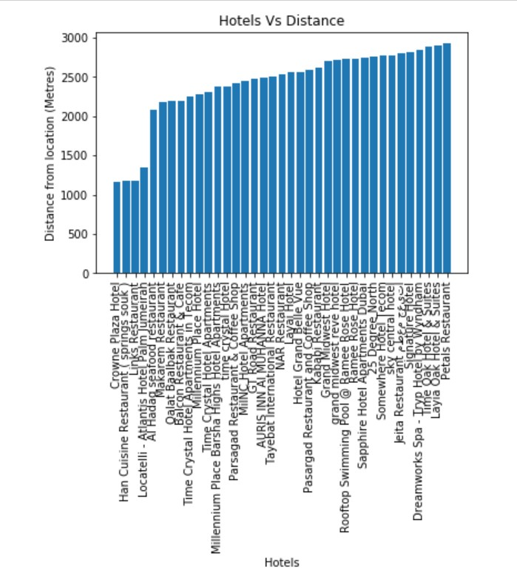
There are 37 hotels/restaurants within 2 km radius captured through foursquare data.
Crown Plaza Hotel is closest to all other hotels.
Petals Restaurant remains far comparative to rest of hotels/restaurants.
Average distance between all hotels to core location is 454 metres
Hotels

Slide 4
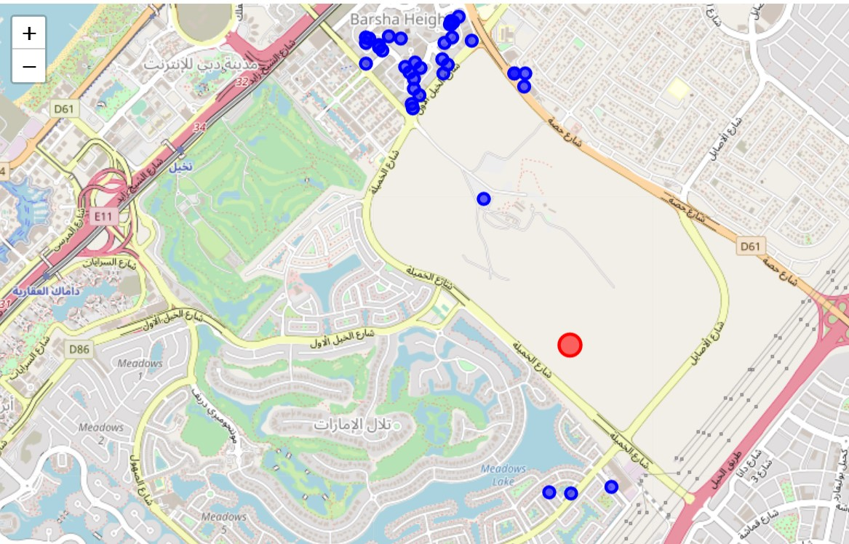
Map - Hotels

Slide 5
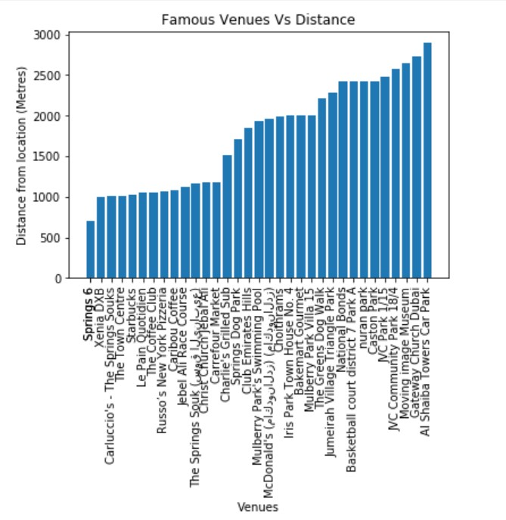
There are 34 Venues within 2 km radius captured through foursquare data.
We see Seasons6 is more closer to our location
Gateway Church Dubai is far from rest of the Venues in Dubai
Starbucks is also an important Venue which is at a 500 meters distance
Venues

Slide 6
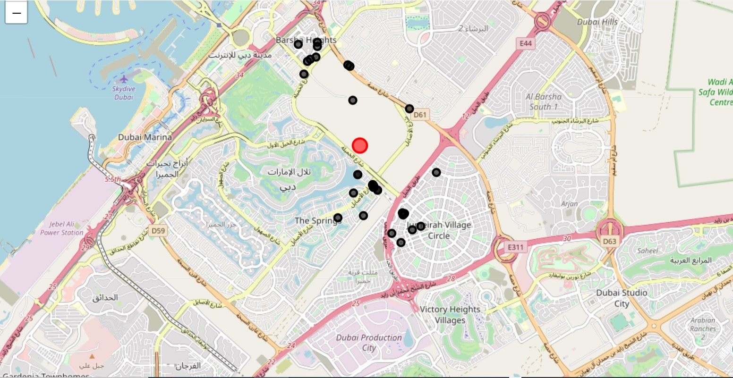
Map - Venues

Slide 7
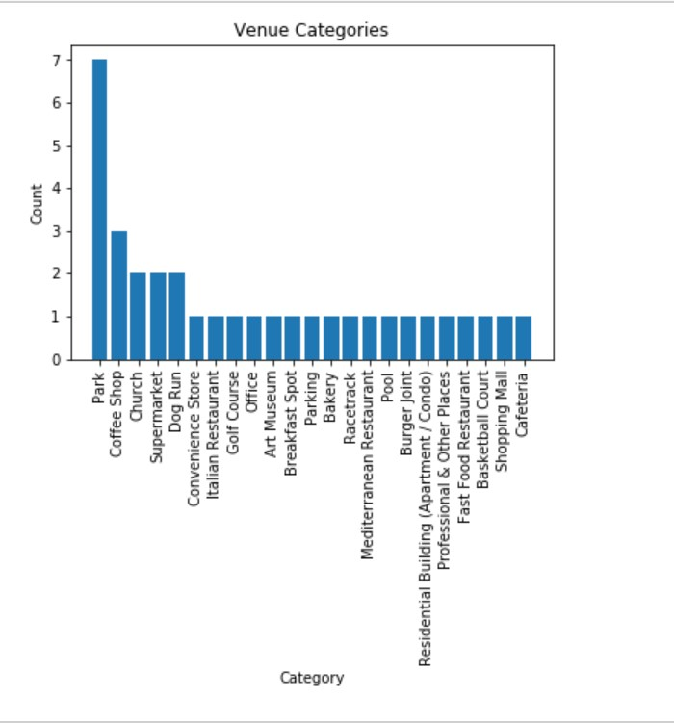
Venues - Category
There are 22 Venue categories within 2 km radius captured through foursquare data.
We can see Parks, coffee shops are more common Venues
Parks are reported with high variation

Slide 8
Prediction
Final Location is Pointed at 25.0714120, 55.1903281
This Location is at Emirates Hills close to Seasons 6 and Crown Plaza Hotel
Located at exact junctions of two cross roads which can give more attention to people who pass by
Main Venues are Parks , Coffee shops, Church, Supermarket

Slide 9
Discussion & Conclusion
From above reports, we could get an idea why the predicted one is pointed/clustered on the given spot. First most thing could be the centre of attraction for the place
KMeans have figured out the most common place for all the venues. This output was very adjacent to the core location. This proves the accurate spotting of our predicted algorithm.
As a business person, one would be able to set up a hotel/restaurant on given spot. This will bring revenue automatically as we have located in very near to core one. We proved this with Kmeans

